Slide 1

Wedding Planner Data Science Capstone Project
Lairai karnik

Slide 2
Introduction
‘Your Fairytale Wedding' is a company based in Toronto which plans larger-than-life, dream weddings for people. The wedding day is a magical one for any couple, signifying new beginnings of a beautiful future together and 'Your Fairytale Wedding' strives to make it as memorable as possible. To achieve this important task, it is required to provide its staff an exhaustive list of all the different places in a given vicinity that come into picture while organizing a wedding so that they can then proceed further, personalizing the wedding experience according to the needs and wants of their clients.

Slide 3
Data Description
The Foursquare location data was used for this project.
Search queries included ‘Hotels and event spaces’, ’Bridal shops, gifts, cosmetics and clothing stores’, ’Churches’, ’Bakery shops’, ’Restaurants’.
’Your Fairytale Wedding’ allows clients to choose their wedding buffet menu from their favorite restaurants, instead of a single catering service, hence the query ‘Restaurants’.
The chosen city was ‘Toronto’ and its latitude and longitude was obtained using Foursquare API in Python.

Slide 4
Data wrangling
Data wrangling or preprocessing formed an important aspect of this project.
The dataframes for each of the locations were cleaned, features which did not convey anything about the location were dropped.
Also, if a single feature had too many NaN values, it was dropped.
All the rows with NaN values were dropped as well as the rows with irrelevant categories were eliminated.

Slide 5
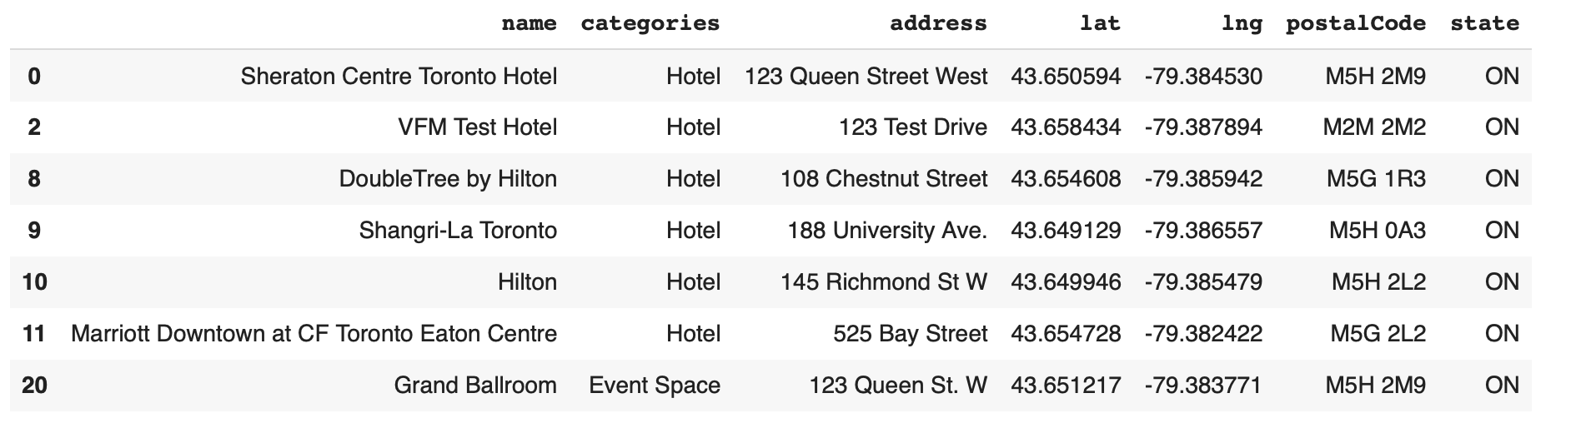
Results
Hotel dataframe after cleaning

Slide 6
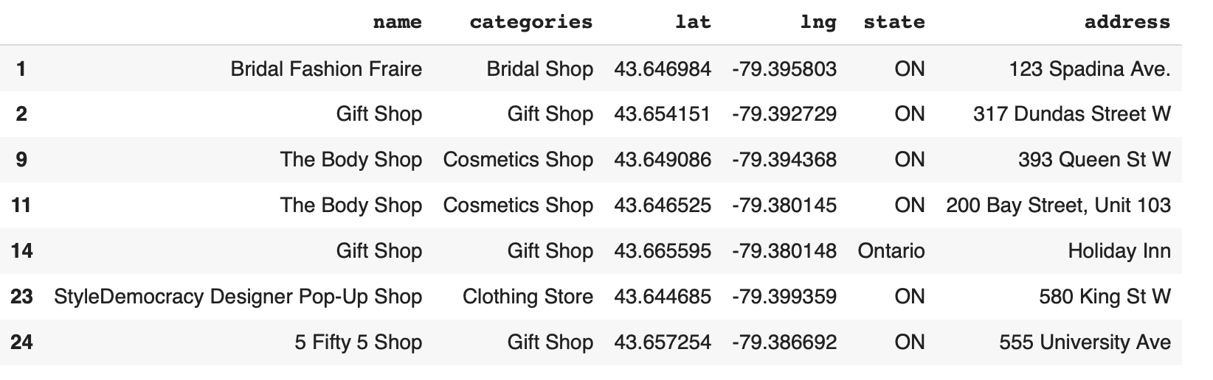
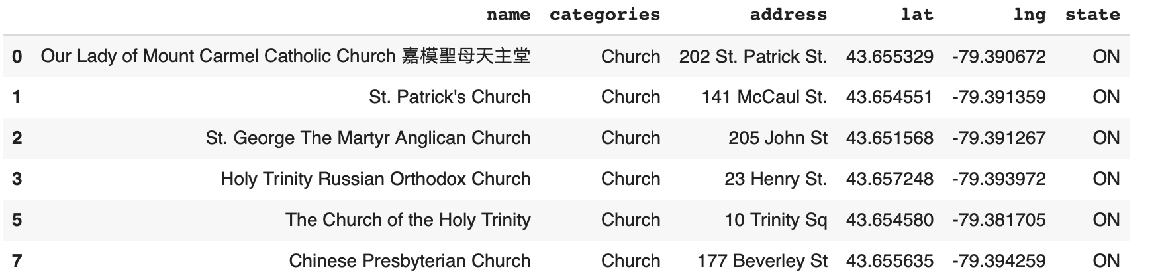
Bridal shops, gifts, cosmetics, clothing shops dataframe after cleaning
Churches dataframe after cleaning

Slide 7
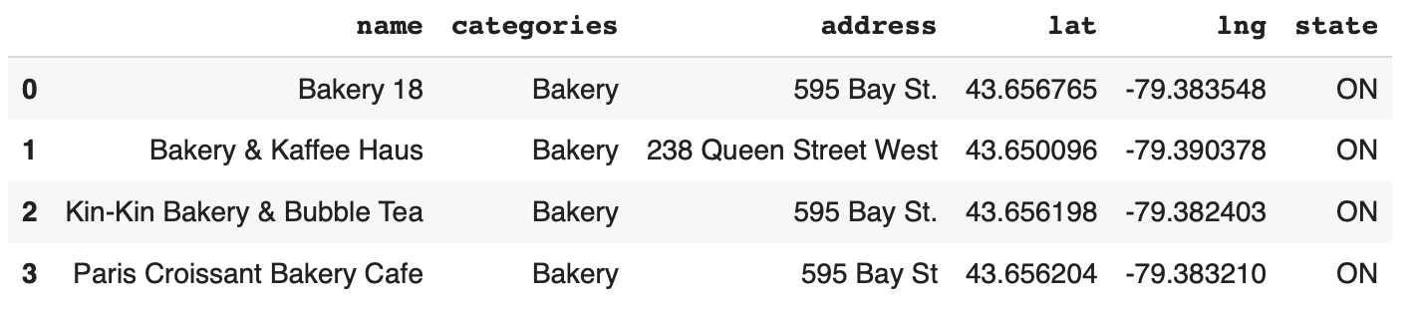
Bakery shops dataframe after cleaning

Slide 8
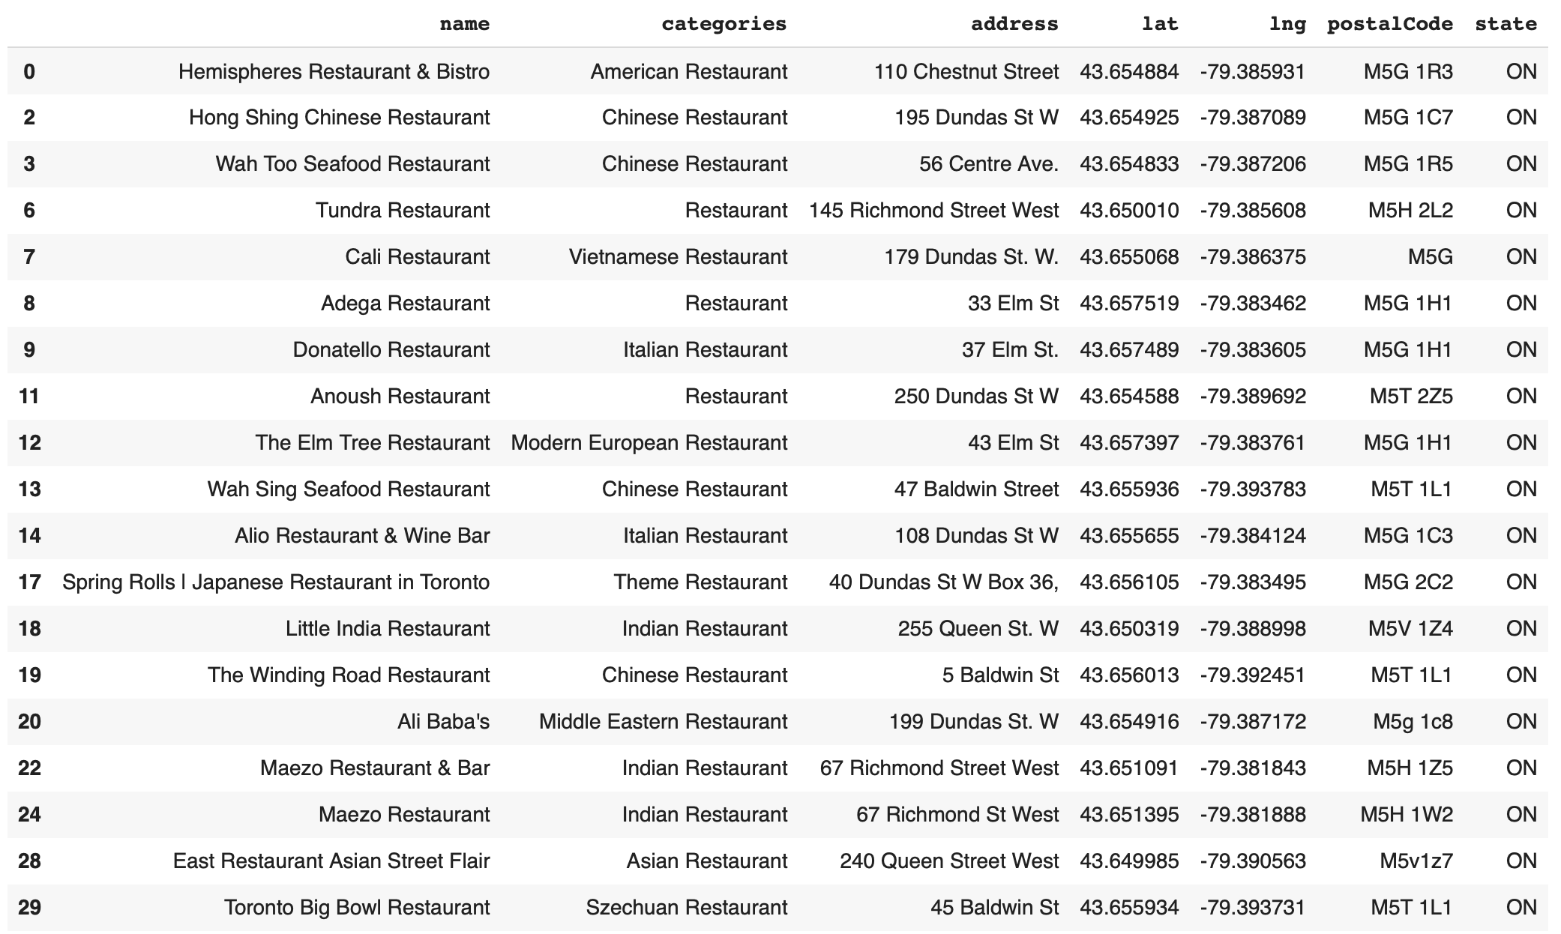
Restaurants dataframe after cleaning

Slide 9
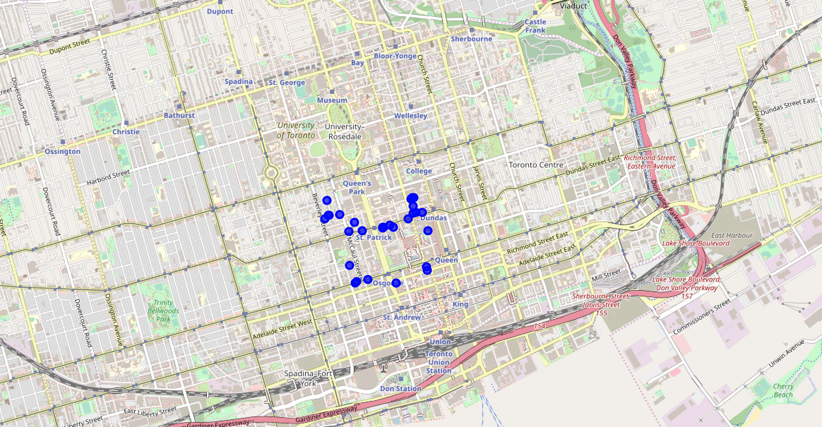
Folium map to visualize church neighborhood including restaurants and bakery shops

Slide 10
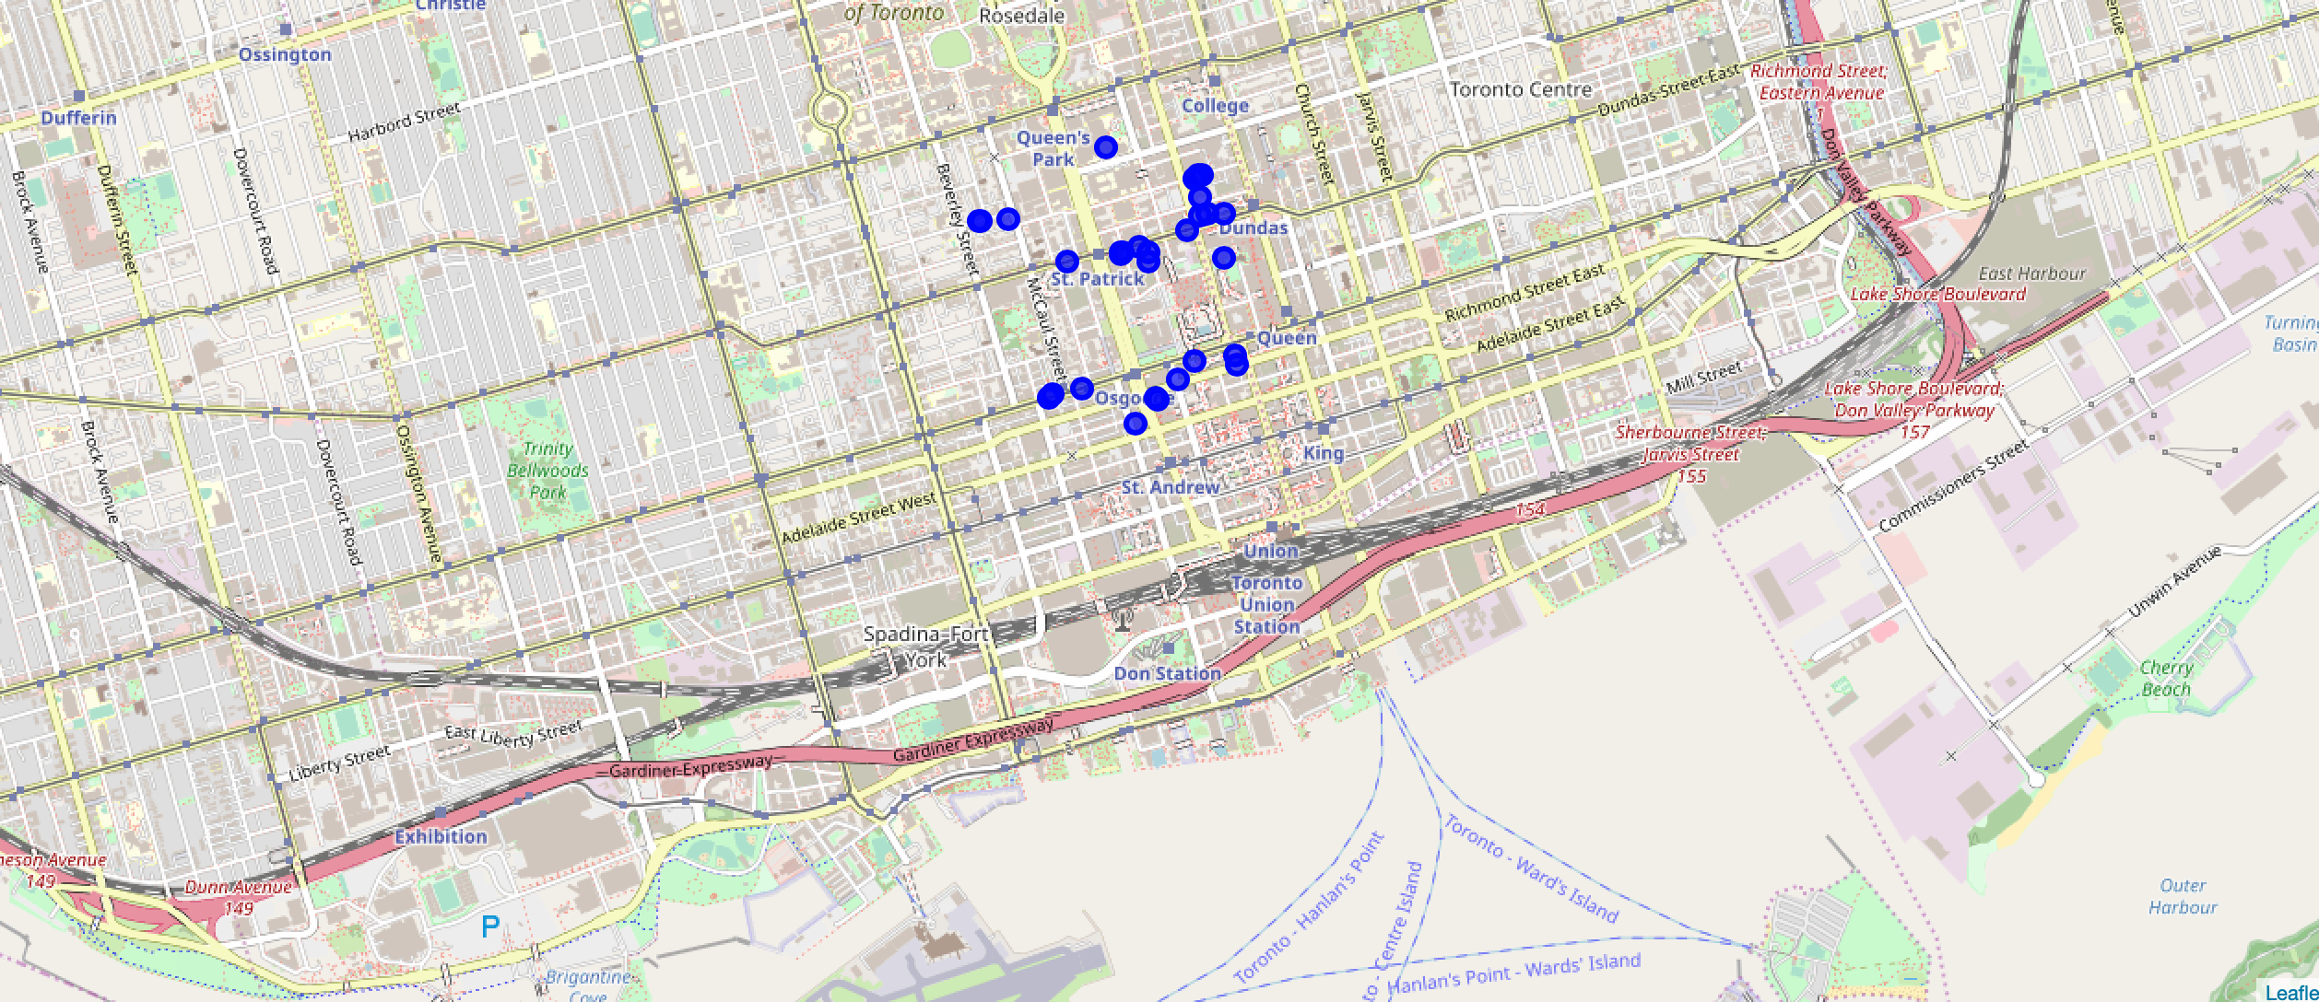
Folium map to visualize hotel and event space neighborhood including restaurants and bakery shops

Slide 11
Conclusion
The cleaned dataframes for each of the locations with concise information are the deliverables which will be a great help to the staff of ‘Your Fairytale Wedding’ in personalizing the wedding experience for different clients.
Additionally, the maps generated using folium library also contribute to acquiring a sound idea of the desired locations with respect to each other and understanding how they cluster together.
Thus, the staff of ‘Your Fairytale Wedding’ can’t wait to craft an unforgettable wedding experience for their clients.
For seeing fellow human-beings happy and beaming joyfully is the ultimate goal of ‘Your Fairytale Wedding’!

Slide 12
Thank You!
View my detailed code here:
https://colab.research.google.com/drive/148Fns-ojMuAAGZzPj1d-Nx2H_bcW-HhC

